Slide 1
CloudClustering
Toward an Iterative Data Processing Pattern on the Cloud
Ankur Dave*, Wei Lu†, Jared Jackson†, Roger Barga†
*UC Berkeley
†Microsoft Research
Notes:
Thanks for the introduction
Undergrad at UC Berkeley
Presenting CloudClustering: data-intensive app on cloud
Questions inline

Slide 2






Ankur Dave
Wei Lu
Jared Jackson
Roger Barga
Notes:
Joint work with Wei Lu, Jared Jackson, and Roger Barga of MSR
Glad to have him in the audience

Slide 3
Background
MapReduce and its successors reimplement communication and storage
But cloud services like EC2 and Azure natively provide these utilities
Can we build an efficient distributed application using only the primitives of the cloud?
Notes:
MapReduce, Dryad, Twister, HaLoop, Spark: useful abstraction for programming the cloud
MapReduce, Dryad: acyclic data flows
Successors: iterative
Communication and storage: sockets, replication
EC2, Azure provide this
Can use only “primitives of the cloud”? -> Simpler

Slide 4
Design Goals
Efficient
Fault tolerant
Cloud-native
Notes:
Fast: data locality and caching
Resilient to failure
Use only existing cloud services -- reliable building blocks

Slide 5
Outline
Windows Azure
K-Means clustering algorithm
CloudClustering architecture
  Data locality
  Buddy system
Evaluation
Related work
Notes:
What we will do:
Used Azure to build CloudClustering
Implements K-Means
CloudClustering architecture: building blocks -> efficient, fault-tolerant
Benchmarks of CloudClustering running on Azure
Related work

Slide 6
Windows Azure
VM instances
Blob storage
Queue storage
Notes:
Windows/.NET based cloud offering
Run user code on VM instances.
Instance fails -> automatically recovered
-> Central blob storage, 3x replicated. Limited by network
-> Queue storage: small messages

Slide 7
Outline
Windows Azure
K-Means clustering algorithm
CloudClustering architecture
  Data locality
  Buddy system
Evaluation
Related work
Notes:
K-Means: widely used, well-understood

Slide 8
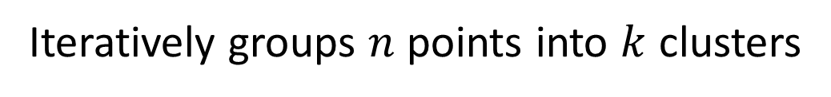
K-Means algorithm
Initialize
Assign points to centroids
Recalculate centroids
Centroids
Points moved?
Iteratively groups $n$ points into $k$ clusters
Notes:
Iterative clustering algorithm
Groups n points into k clusters, n >> k
-> Initial set of cluster centers -> centroids
-> Points assigned to closest centroids
-> Centroids move to average of their points
-> Repeats until convergence

Slide 9
K-Means algorithm
Initialize
Partition work
Assign points to centroids
Compute partial sums
Recalculate centroids
Points moved?
Notes:
Easy to parallelize
Master: initial centroids
-> Partition points, split across workers
-> On workers, same as before for partition
-> All returned: averages, move centroids
-> Iterate until convergence

Slide 10
Outline
Windows Azure
K-Means clustering algorithm
CloudClustering architecture
  Data locality
  Buddy system
Evaluation
Related work
Notes:
How it’s implemented

Slide 11

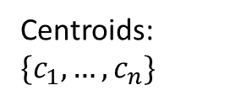
Architecture
Initialize
Partition work
$$⋮$$
Assign points to centroids
Centroids: $\{c_{1}, …, c_{n}\}$
Compute partial sums
Recalculate centroids
Points moved?
Notes:
Master supervises pool of workers
-> Coordinate using queues
-> First, master loads input into blob storage
-> Generates initial centroids
-> Sends command to workers: ptr to partition, list of centroids
-> Workers do computation
-> Generate partial sums
-> All returned: master recalculates centroids
-> Next iteration

Slide 12
Outline
Windows Azure
K-Means clustering algorithm
CloudClustering architecture
  Data locality
  Buddy system
Evaluation
Related work
Notes:
2 modifications for efficiency and fault tolerance
First: data locality

Slide 13
Data locality
$$⋮$$
Single-queue pattern is naturally fault-tolerant
Problem: Not suitable for iterative computation
Multiple-queue pattern unlocks data locality
Tradeoff: Complicates fault tolerance
Notes:
Conventional: single queue
Fault tolerance easy. All state in messages. Failure -> throughput reduced
No good for iterative: no data locality
-> Multiple queues: unlocks data locality
But complicates fault tolerance

Slide 14
Outline
Windows Azure
K-Means clustering algorithm
CloudClustering architecture
  Data locality
  Buddy system
Evaluation
Related work
Notes:
Efficiency with fault tolerance: buddy system

Slide 15
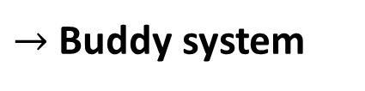
Handling failure
Initialize
Partition work
Assign points to centroids
Compute partial sums
Stall?
$→$ Buddy system
Recalculate centroids
Points moved?
Notes:
Why failure is a problem?
-> When worker fails
-> Can’t report to master
-> Stall
-> Buddy system

Slide 16
Buddy system
Buddy system provides distributed fault detection and recovery
Notes:
Conventional: heartbeat over sockets
Design goals: use cloud services
Insight: working on task when fail. Queue reliable -> have a record
Peer-to-peer: master assigns into buddy groups
-> Each polls queues of others
-> When fail
-> Tasks in queue for longer than timeout
-> Buddies dequeue tasks, complete them
Size: tradeoff between fault tolerance and network traffic
Large group -> resilient to simultaneous, but more polling traffic (charge per transaction)

Slide 17
Buddy system
Fault domain
1
2
3
Spreading buddies across Azure fault domains provides increased resilience to simultaneous failure
Notes:
Fault domains: reduce likelihood of sim.fail
Fault domains: prob. of sim.fail
Allocation algorithm spreads across fault domains

Slide 18
Buddy system
vs.
…
Cascaded failure detection reduces communication and improves resilience
Notes:
Workers -> nodes in graph
Edges -> polling queue of another instance
Buddy system: disconnected cliques
-> Alternative: cascaded failure detection
Total ordering of workers
Each polls the next, circular
Less traffic, better resilience
Future work

Slide 19
Outline
Windows Azure
K-Means clustering algorithm
CloudClustering architecture
  Data locality
  Buddy system
Evaluation
Related work
Notes:
Performance

Slide 20
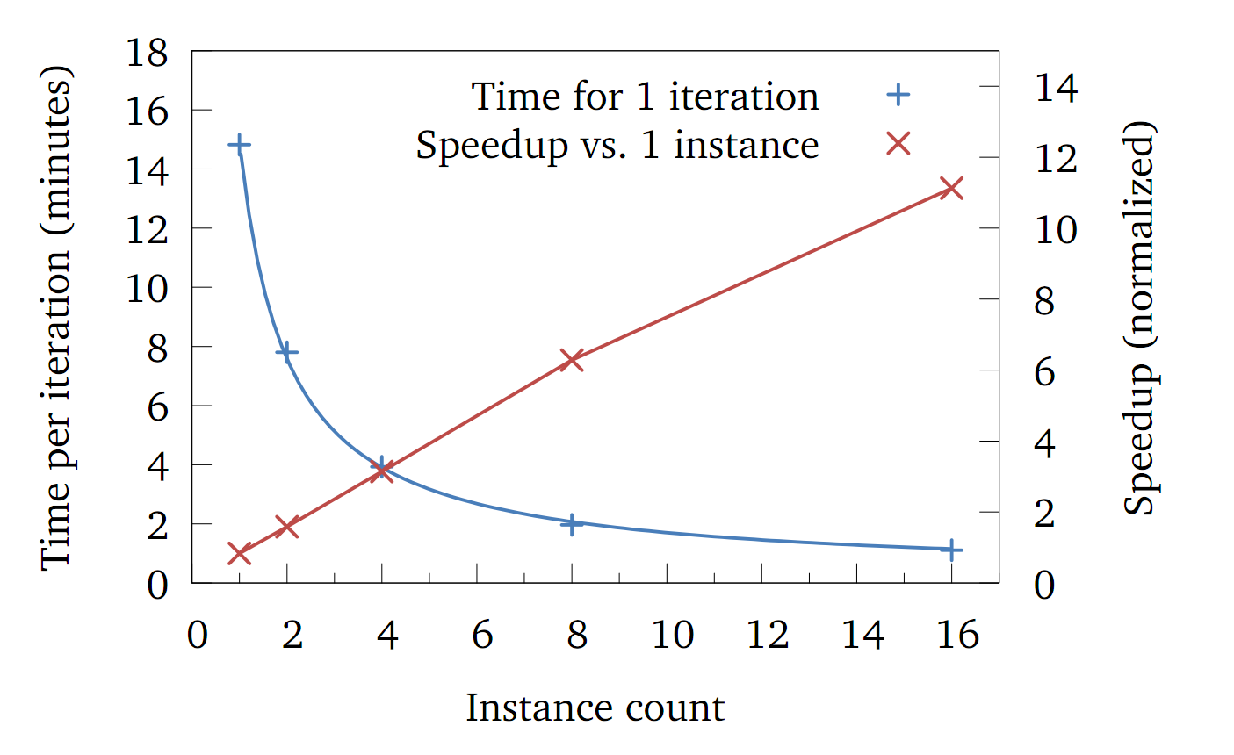
Evaluation
Linear speedup with instance count
Notes:
Linear speedup as increase number of instances
16 instances and 1 GB data

Slide 21
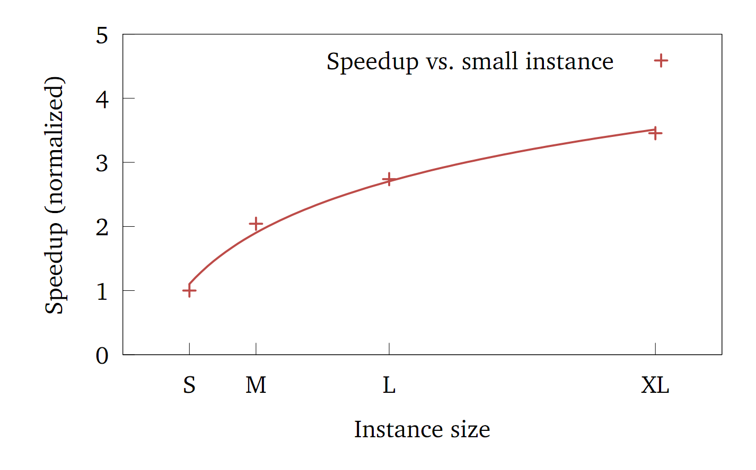
Evaluation
Sublinear speedup with instance size
Reason: I/O bandwidth doesn’t scale
Notes:
Sublinear speedup with faster machines
Because I/O bandwidth doesn’t always improve
Use multiple threads, but I/O is bottleneck

Slide 22
Outline
Windows Azure
K-Means clustering algorithm
CloudClustering architecture
  Data locality
  Buddy system
Evaluation
Related work
Notes:
Related work

Slide 23
Related work
Existing frameworks (MapReduce, Dryad, Spark, MPI, …) all support K-Means, but reimplement reliable communication
AzureBlast built directly on cloud services, but algorithm is not iterative
Notes:
All frameworks support K-Means
MapReduce, Dryad: no iteration, launch from driver
Implement communication using sockets
AzureBlast: NCBI-BLAST genetic tool on cloud services
Not iterative -> different challenges

Slide 24
Conclusions
CloudClustering shows that it's possible to build efficient, resilient applications using only the common cloud services
Multiple-queue pattern unlocks data locality
Buddy system provides fault tolerance
Notes:
Can build efficient, resilient with only cloud services
Helpful patterns: multiple queues, buddy system

